Slide 1
Siskiyou County Agricultural Preserve and Williamson Act Program Update
Rules for the Establishment and Administration of Agricultural Preserves and Williamson Act Contracts 2024 Revisions Discussion

Slide 2
County Total Acres 4,062,446 Federal/State 2,477,868
Federal/State

Slide 3
County Total Acres 4,062,446 Federal/State 2,477,868 Incorporated 22,368
Federal/State
Incorporated City

Slide 4
County Total Acres 4,062,446 Federal/State 2,477,868 Incorporated 22,368 Restricted by Zoning 586,761
Federal/State
Restricted Zoning
Incorporated City

Slide 5
County Total Acres 4,062,446 Federal/State 2,477,868 Incorporated 22,368 Restricted by Zoning 586,761 Unrestricted Agricultural 560,207
Federal/State
Restricted Zoning
Incorporated City
Unrestricted Agricultural Land

Slide 6
County Total Acres 4,062,446 Federal/State 2,477,868 Incorporated 22,368 Restricted by Zoning 586,761 Unrestricted Agricultural 560,207 Williamson Act Contract 415,240
Federal/State
Restricted Zoning
Incorporated City
Unrestricted Agricultural Land
Williamson Act Encumbered

Slide 7
Unincorporated Privately Owned 1,562,310 acres Restricted by Zoning 37.5% Williamson Act Contract 26.5% Unrestricted Agricultural 36%
Federal/State
Restricted Zoning
Incorporated City
Unrestricted Agricultural Land
Williamson Act Encumbered

Slide 8
2025 Estimates 415,470.8 acres under contract 10,754.96 acres under Non-Renewal
2024 Data
415,240 acres under Contract 5937.08 acres in Non-Renewal process 4817.88 acres issued a Notice of Non-Renewal 230.8 acres approved to include in contracts

Slide 9
538 Individual Contracts 86 Multi-Owner Contracts 104 Agricultural Preserves

Slide 10
County Guidelines Update
Rules for the Establishment and Administration of Agricultural Preserves and Williamson Act Contracts
Adopted on February 7, 2021
Amended on December 13, 2022

Slide 11
Staff Recommendations

Slide 12
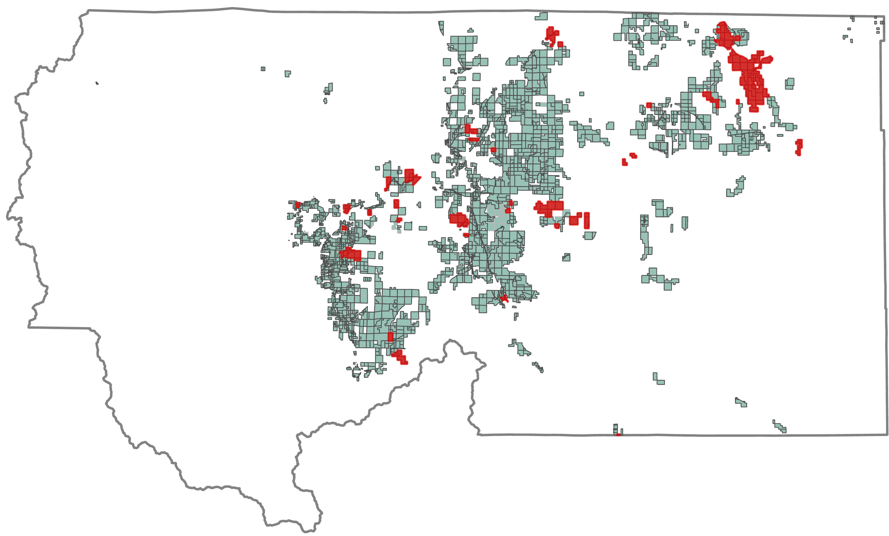
Non-conforming Ag Preserves
Staff Recommendation #1
The majority of Agricultural Preserves no longer meet current requirements as the parcels are not contiguous nor owned in common.
The example provided is of property within Ag Preserve established by Board Resolution 303 in Book 7.
There are 32 different property owners under this Ag Preserve.
Williamson Act Encumbered
Within Example Ag Preserve
Option 1
Remove all property currently under Williamson Act Contract from the existing Ag Preserves and bring all that property under one single Preserve.
Option 2
Continue to amend the existing Ag Preserves as Williamson Act Contract amendment applications are processed.

Slide 13
Primary Use - Timber Production
Staff Recommendation #2
Option 1
Remove the Growing and Harvesting of Timber from allowed Primary Agricultural Uses
Option 2
Revise the guidelines to not restrict land dedicated to the Growing and Harvesting of Timber with the existing Soils Requirements and increase the required parcel acreage.

Slide 14
Application Requirements
Staff Recommendation #3
Parcel Creation
Option 1
Allow for applicants to provide proof that their parcel was legally created, lienholder information and details on other encumbrances in lieu of a Title Report
Option 2
No change. Continue to require a title report with the submittal of a Williamson Act/ Ag Preserve amendment application

Slide 15
Substandard Parcels
Staff Recommendation #4
Option 1
Revise the guidelines to allow prime agricultural parcels to remain under contract should the Board find that the parcel is a necessary part of the agricultural operation.
Option 2
Continue to require that all parcels are at least 40 acres in size unless the primary use is intensive, such as growing fruits, nuts or vines.

Slide 16
Minor Amendment Option
Staff Recommendation #5
Option 1
Allow the Ag Preserve Administrator to approve a Change in Use as a Minor Contract Amendment. This would decrease the fees for this type of project by 50%.
Option 2
Continue to process a Change in Use as a Williamson Act Contract/Ag Preserve Amendment project, with Board of Supervisor approval.

Slide 17
Additional Housekeeping
Revised Compatible Uses
to include Short Term Vacation Rentals
Remove the term ‘Agritourism’
Clarified responsibility of landowner as to entering Conservation Easements and Programs
Revised Notice of Non-Renewal
Provided clarification on the withdrawal process for a Notice of Non-Renewal as it varies depending upon who originally issued the notice.

